Slide 1
Lab 3 Walkthrough

Slide 2
Lab 3 Components
Data Aggregation
Sometimes we are interested in the result of aggregating multiple data items rather than in individual data items.
We’ll learn about aggregate concepts, aggregate functions, counting, obtaining maximums and minimums, group by clauses, having clauses, and combining aggregation with joins.
Data Visualization
You’ll learn how to visually tell a story about information in a way that people quickly and accurately understand it.

Slide 3

Section 1: aggregating Data

Slide 4
Aggregate Functions
Standard Function | Aggregate Function
Always yields one result per row | Always yields a single value across all rows, or across groups of rows

Slide 5
Aggregate Functions
Standard Function | Aggregate Function
Always yields one result per row | Always yields a single value across all rows, or across groups of rows
For input, always uses value(s) from a single row of data | For input, uses multiple rows of data

Slide 6
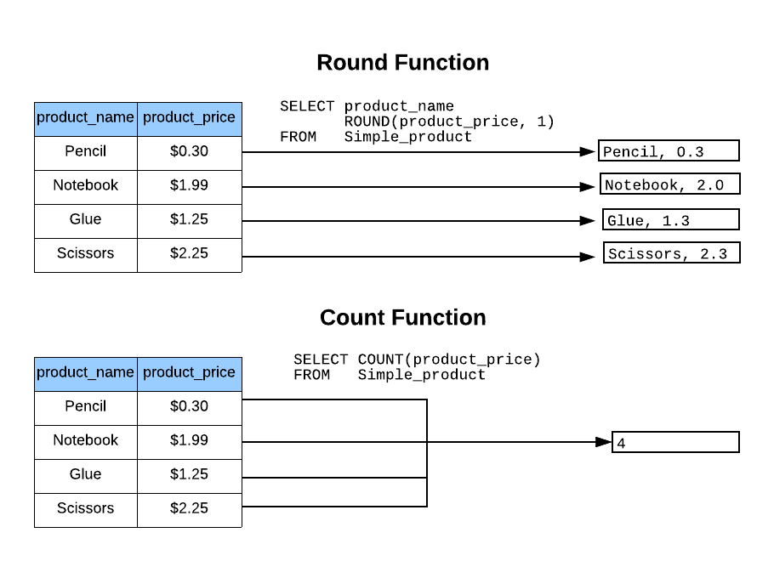
Contrast of Count to Round

Slide 7
Types of Aggregation
In theory there are virtually an unlimited number of aggregations that can be performed.
Some DBMS allow you to define your own (possible, yet technically challenging).
Built-in functions can be broadly categorized:
Numeric
String
Date

Slide 8
Common Numeric Functions
Count – Counts the number of rows or the number of rows without a null for a column.
Min – Returns the smallest number (or date) in the result set for a column.
Max – Returns the largest number (or date) in the result set for a column.
Sum – Adds up the values in a column across the rows in the result set.

Slide 9
Step 1
Creating Table Structure and Data

Slide 10
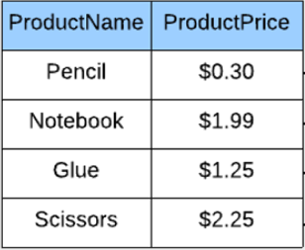
Simple Product Table

Slide 11
Step 2
Counting Matches

Slide 12
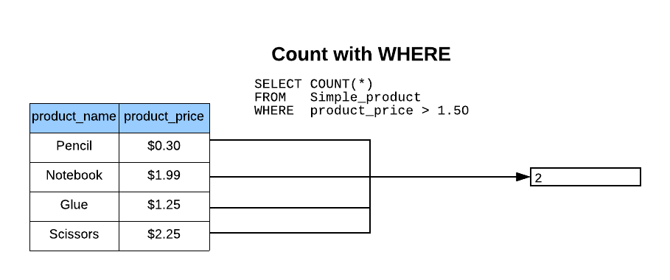
Count with WHERE

Slide 13
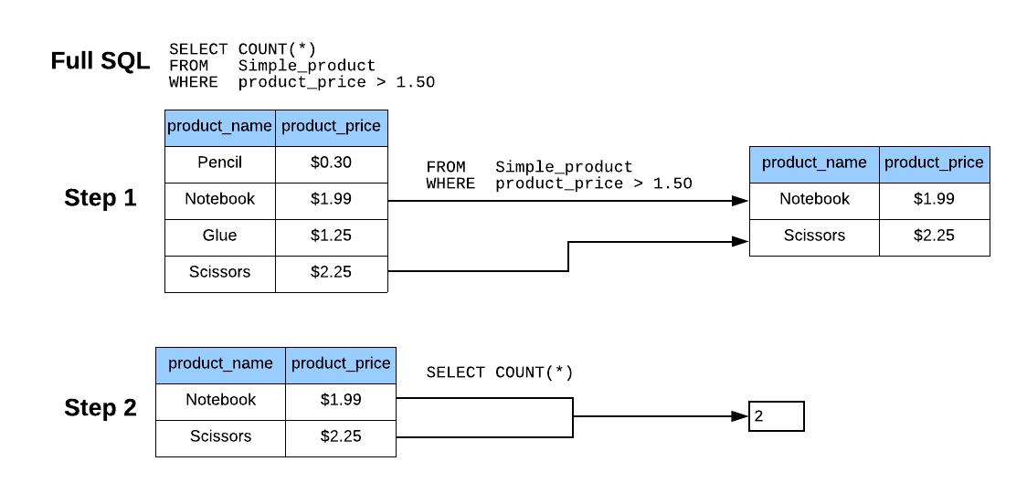
Order of WHERE

Slide 14
Step 3
Determining Highest and Lowest

Slide 15
Step 4
Grouping Aggregate Results

Slide 16
Groups
By default, an aggregate function is executed across all rows in the result set.
Alternatively, rows can be grouped together, and an aggregate function can be executed one for each group.
The GROUP BY keyword specifies which column(s) define the group.
With GROUP BY, the aggregate function is executed once for each unique value for the column, or combination of unique values if more than one column is specified.

Slide 17
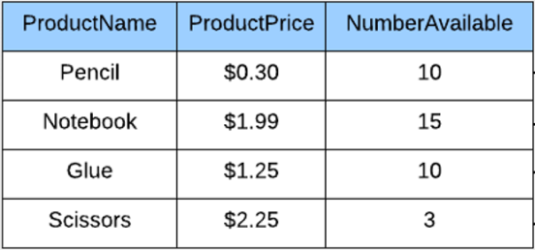
Product Table with Third Column

Slide 18
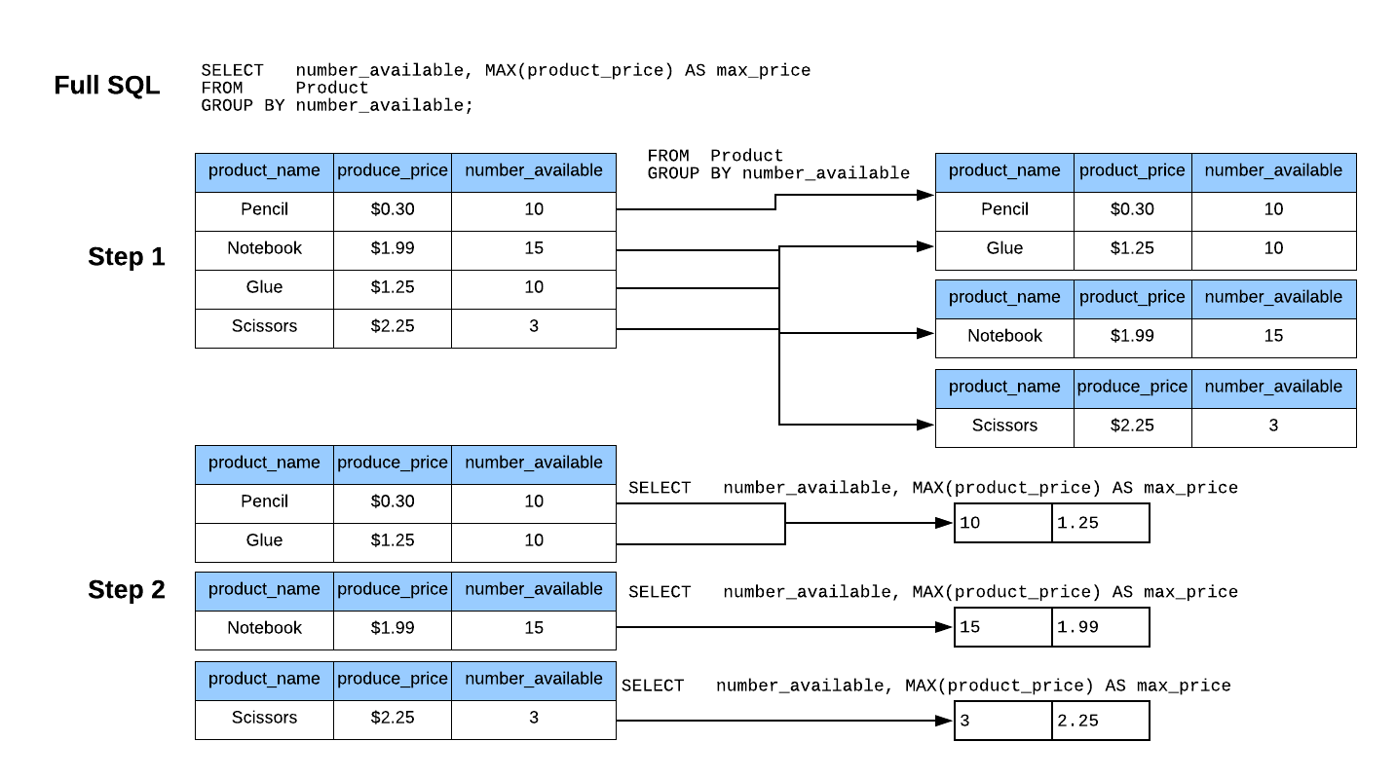
Group Order of Operations

Slide 19
Step 5
Limiting Results by Aggregation

Slide 20
Limiting Results by Aggregation
The WHERE clause limits the underlying row-by-row results, while the HAVING clause limits the results by the results of the aggregation.
For example, you could sum up the number of students enrolled in each course, then use the HAVING clause the limit the results where the number of enrolled students is greater than 15.

Slide 21
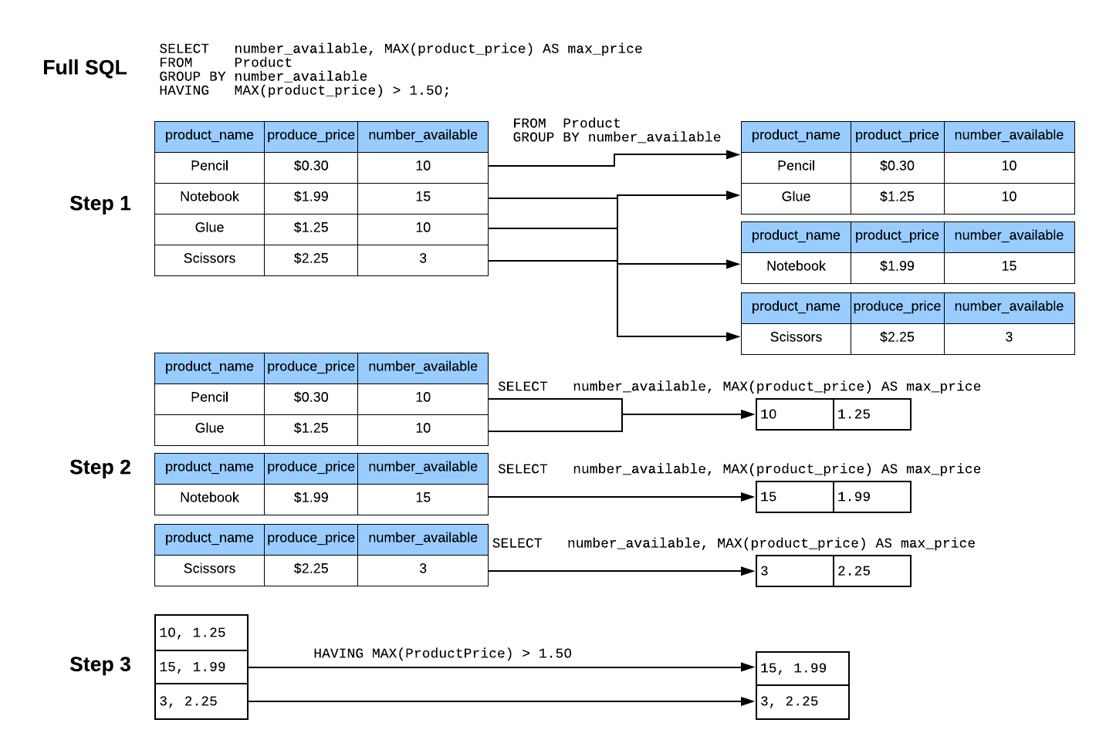
HAVING Order of Operations

Slide 22
Step 6
Adding Up Values

Slide 23
Step 7
Integrating Aggregation with Other Constructs

Slide 24
Integrating Aggregation
Aggregation can be combined with any of the constructs you have learned previously – WHERE, JOINS, and ORDER BY.
One very important concept is to understand the overall order of operations, because that determines what the results will look like.

Slide 25
Order of Operations Summary
FROM – Specifies which tables to pull data from (in later weeks you’ll learn how subqueries can be placed here too).
WHERE – Filters individual rows based on conditions.
GROUP BY – Groups fields for aggregate functions.
HAVING – Filters rows based upon aggregate values.
SELECT (Column List)- Selects which columns and aggregates to keep in the result set.
ORDER BY – Orders the result set by one or more selected columns.

Slide 26
Section 2: Data Visualization

Slide 27
Data Visualization Overview
The focus of data visualization is to tell a visual story about the information in a way that people quickly and accurately understand it.
Learning to use the data in your database to tell data stories is very important. All industries are rapidly becoming data driven; personal experience and educated guesses are no longer sufficient to remain competitive in today’s world.

Slide 28
StepS 8-9
Visualizing Data with One or Two Measures
Another Data Visualization

Slide 29
Steps for Producing a Graph
While I show you how to do this using Excel, no graphing tool is mandated for this course.
General Steps:
Execute a SQL query that produces useful results.
Save the results of that SQL query as a CSV file.
Import that CSV file into Excel.
Use Excel to chart the results.

Slide 30
Demo of One and Two Measure Visualization

Slide 31

End

